Slide 1
CSE 575 Class Project Presentation Weather Forecasting
Team Members:
Balaji Sankar – 1209346459 - bsankar@asu.edu – 20% contribution
Karthik Subramanian – 1209360876 - ksubra19@asu.edu – 20% contribution
Aarti Rao Manjeshwar – 1209163211 - amanjesh@asu.edu – 20% contribution
Shwetha Narayanan – 1209166097 - snaray36@asu.edu – 20% contribution
Ramanathan Nachiappan – 1210822532 – rnachiap@asu.edu - 20% contribution

Slide 2
Overview
Introduction
Data Sets
Time Series Data modelling
Proposed approaches
PCA and Feature Selection
Baseline - Naïve Persistence model
ARIMA Modeling
Time Series Linear Modeling
Nearest Neighbor Modeling
LSTM
Results

Slide 3
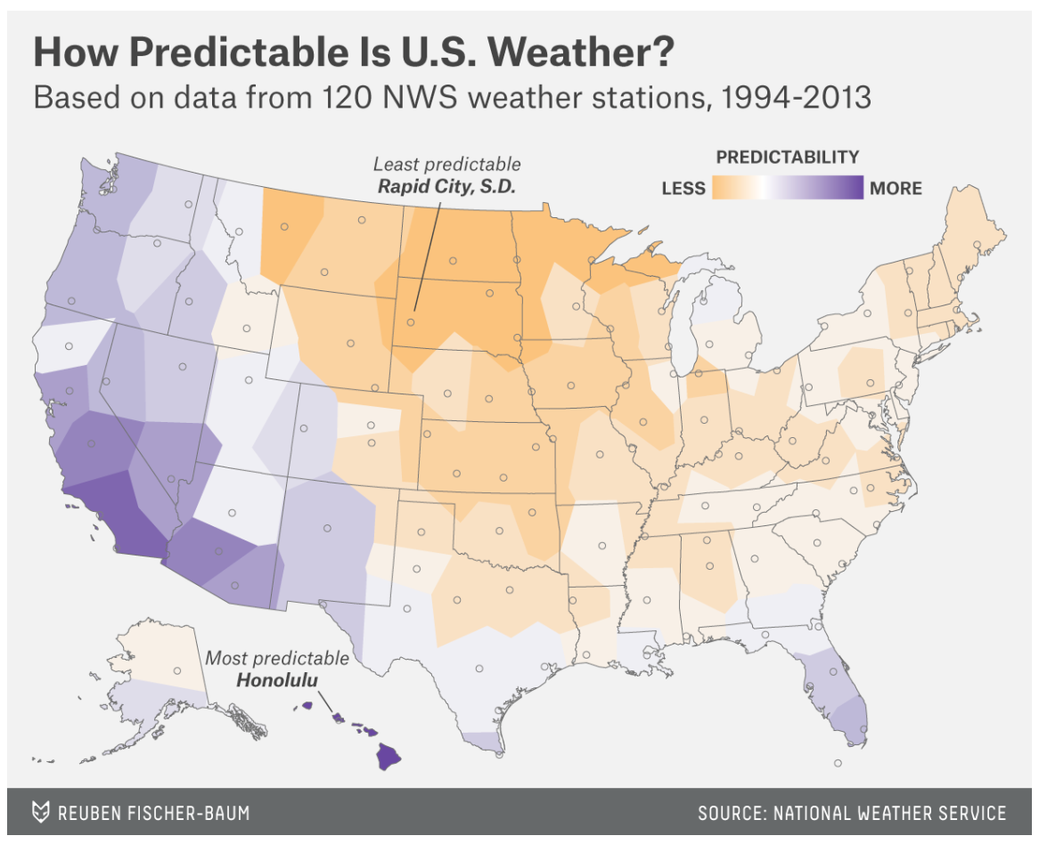

Slide 4
Data Sets
Source: http://www.noaa.gov/
National Oceanic and Atmospheric Administration by the U.S Department of Commerce
Data Set Sample:
Seattle, Dallas and Cincinnati Weather data
Parameters – Sunrise, sunset, wind speed, precipitation, dew point, wet bulb temperature, pressure change, sky conditions etc. (92 features)

Slide 5
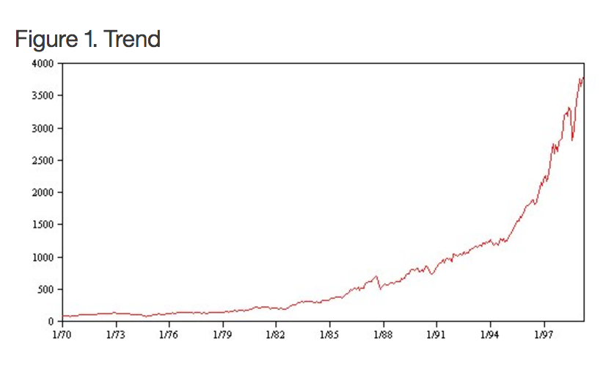
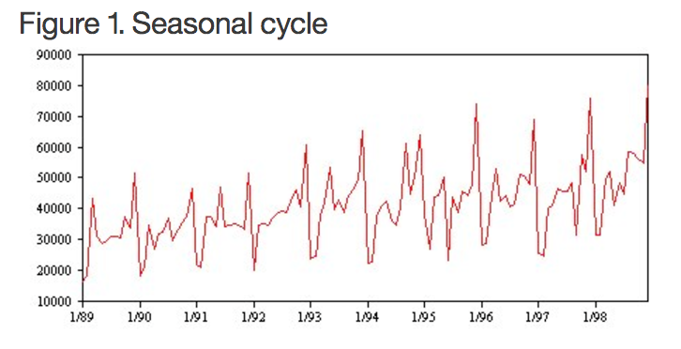
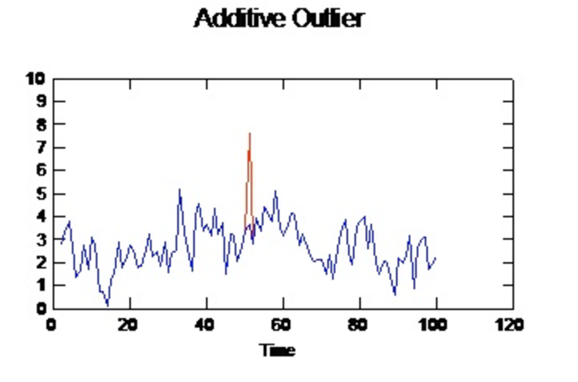
Time Series Characteristics

Slide 6
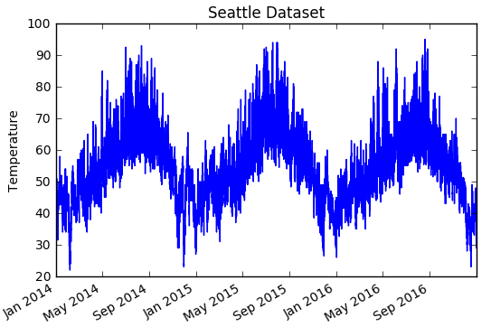
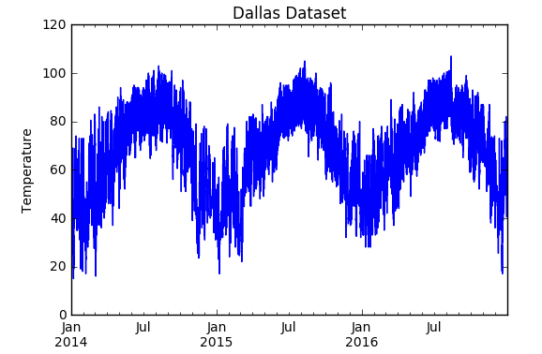
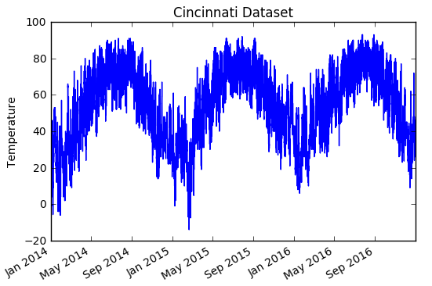
Weather is seasonal!

Slide 7
Proposed Approaches
Data Set Feature Extraction using PCA
Feature Selection – Stepwise Regression
Base model using Naïve Persistence
ARIMA Modeling
Time Series Linear Modeling
K Nearest Neighbor Modeling
LSTM

Slide 8
Preprocessing
Original features | 92
Reduced manually | 19
Aggregated data | collapsed into hourly
Note : Some features were redundant. For example, there was a column
with temperature in Celsius and then there was another column, describing
the same in Fahrenheit. We manually removed these features

Slide 9
Feature Extraction using PCA
Find variance of each column
Sort by variance of each column
Find the number of columns which has a variance greater than 1.
This represents the ideal set of features
High variance indicates that the feature is not closely related to other features.

Slide 10
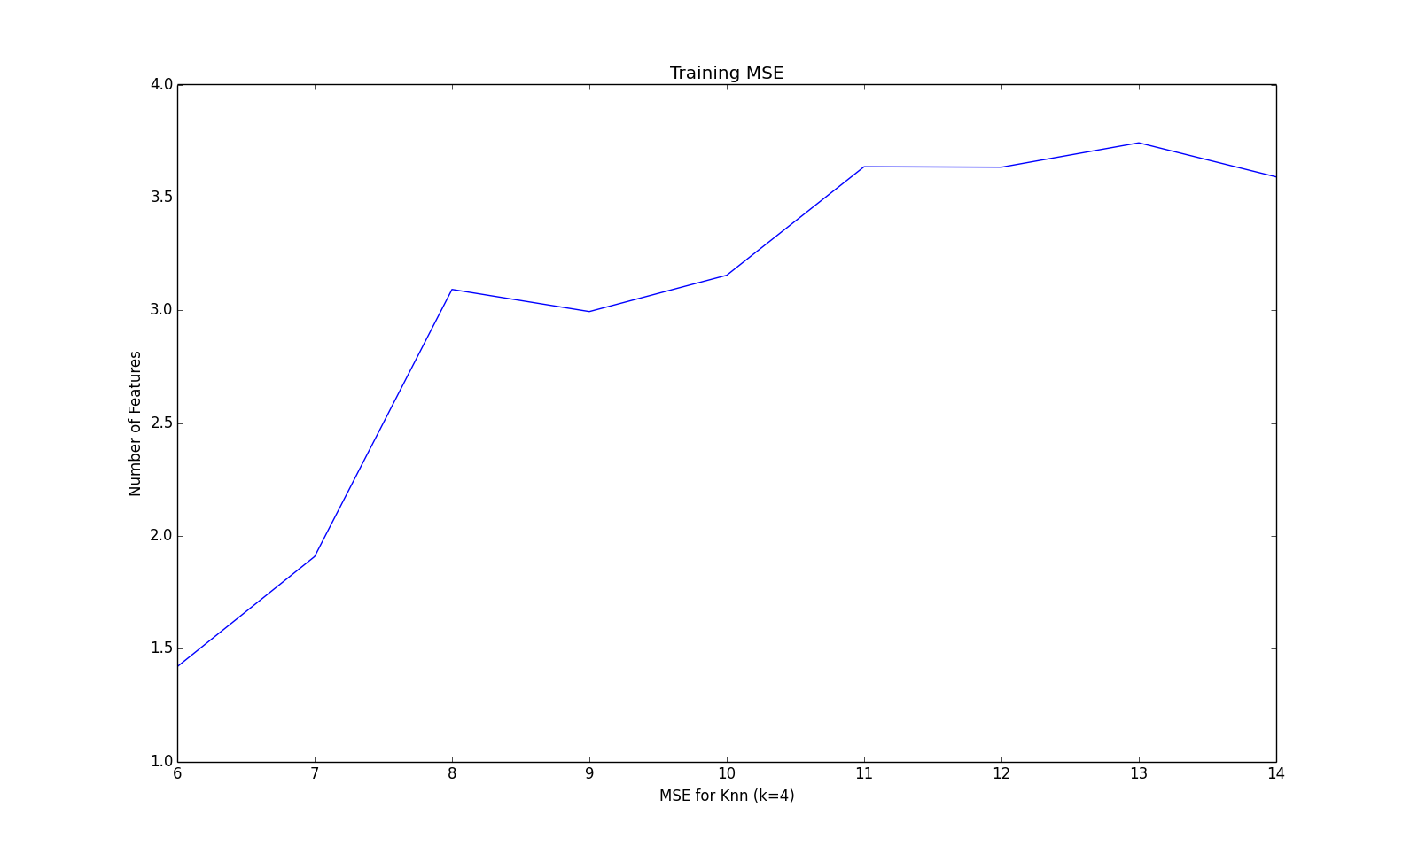
Choosing Number of Dimensions for PCA

Slide 11
Recursive Feature Elimination using LR
Using PCA, we decided on the number of features to be 11 based on the feature variances.
We used Logistic Regression in our Recursive Feature Elimination process.
Our RFE kept eliminating features until we were left with only 11 features.

Slide 12
Logistic Regression for Feature Selection
Selected Features:
HOURLY ALTIMETER SETTING
HOURLY DEW POINT TEMPERATURE IN F
HOURLY PRESENT WEATHER TYPE – Snow, Rain etc.
HOURLY PRESSURE TENDENCY – Increase, decrease or no change in pressure over the last 3 hrs.
HOURLY RELATIVE HUMIDITY
HOURLY SEA LEVEL PRESSURE
HOURLY SKY CONDITIONS – Clear sky, few clouds, scattered clouds etc.
HOURLY STATION PRESSURE
HOURLY VISIBILITY
HOURLY WET BULB TEMPERATURE IN F
HOURLY WIND SPEED

Slide 13
Step-wise regression for feature selection
Selected Features
Cincinnati | Precipitation, Pressure and Visibility
Dallas | Humidity, Wind Direction and visibility
Seattle | Wet bulb temperature, precipitation, pressure change

Slide 14
Baseline Prediction for Time Series
We used the persistence algorithm in establishing the baseline performance
Persistence Algorithm:
Also called “Naïve” Forecast which is equivalent to the ‘Zero Rule’ algorithm
This algorithm uses the value at the previous time step t-1 (input) to predict the outcome in the next time step t+1 (output)
Dataset split – Training -2/3rd and Testing – 1/3rd
This assumes nothing about the specifics about the time series to which it is applied, thus making it naïve and establishing a baseline performance

Slide 15
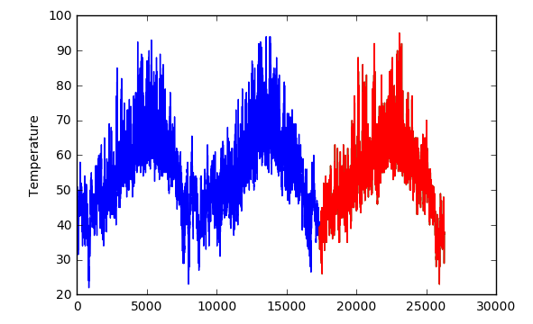
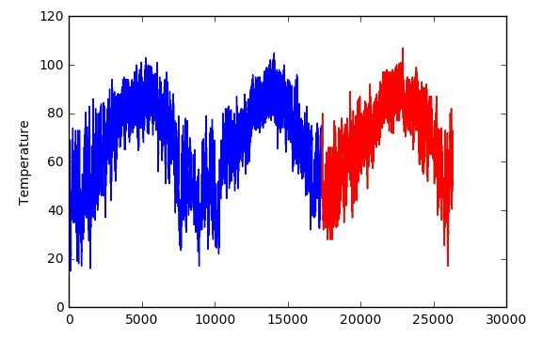
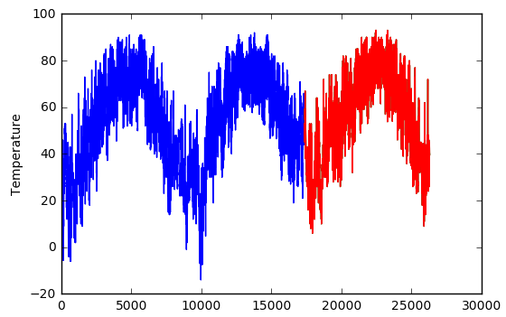
Predictions
Seattle
Dallas
Cincinnati

Slide 16
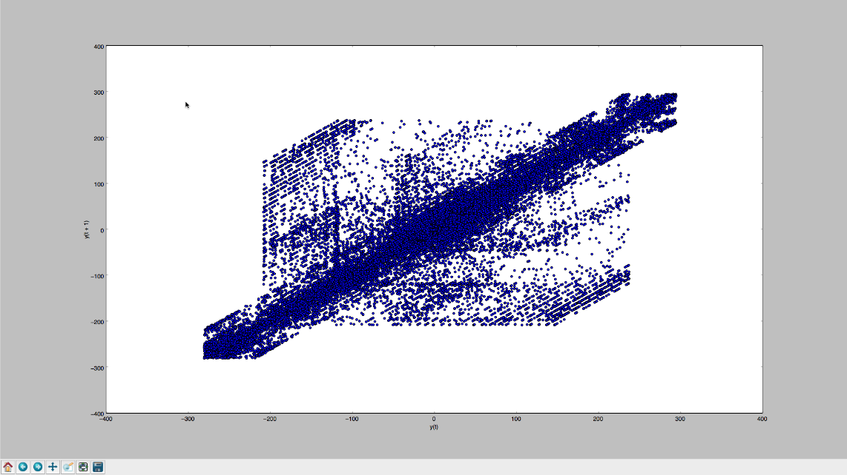
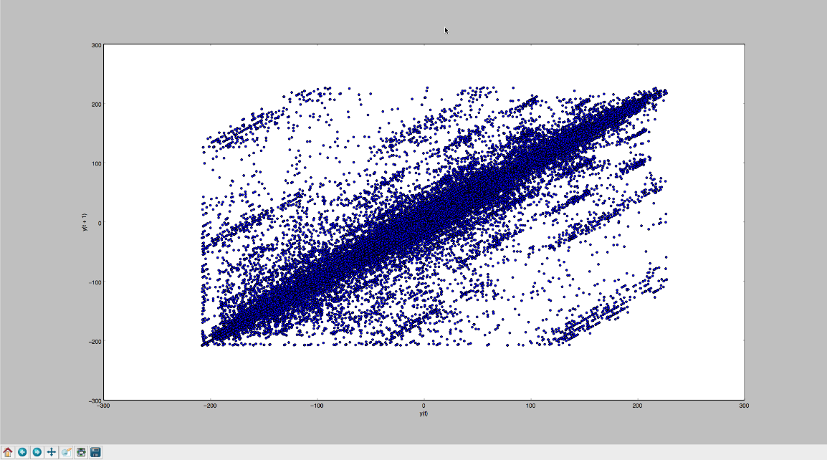
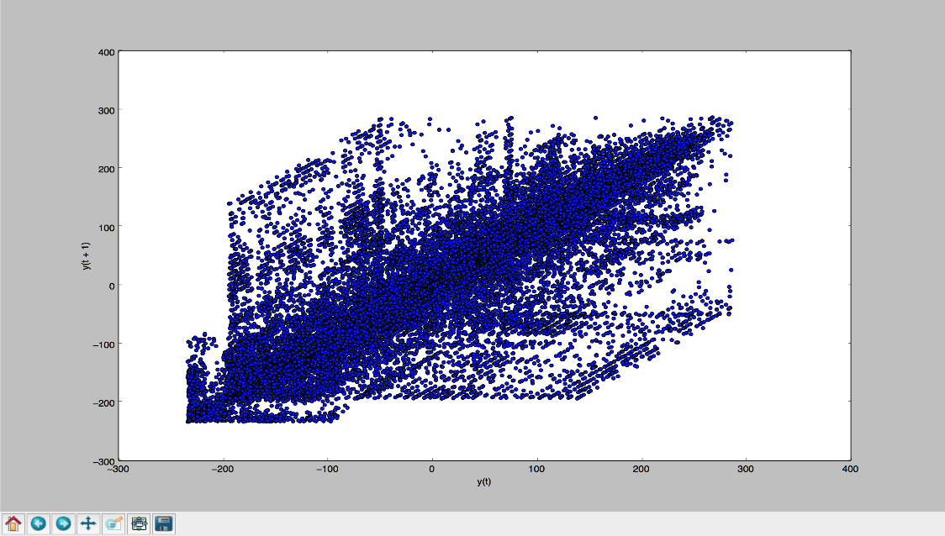
Correlation Check between t-1 and t+1
Seattle
Dallas
Cincinnati

Slide 17
AR Modeling
AR model is similar to the baseline prediction model in terms of predicting outcome using the observation of the previous time step
However the approach is not naïve, but based upon linear regression model (a linear combination of input values)
For example X(t+1) = w0 + w1*X(t-1)
This relationship between variables is called correlation and we performed a correlation check for the two variables t+1 and t-1

Slide 18
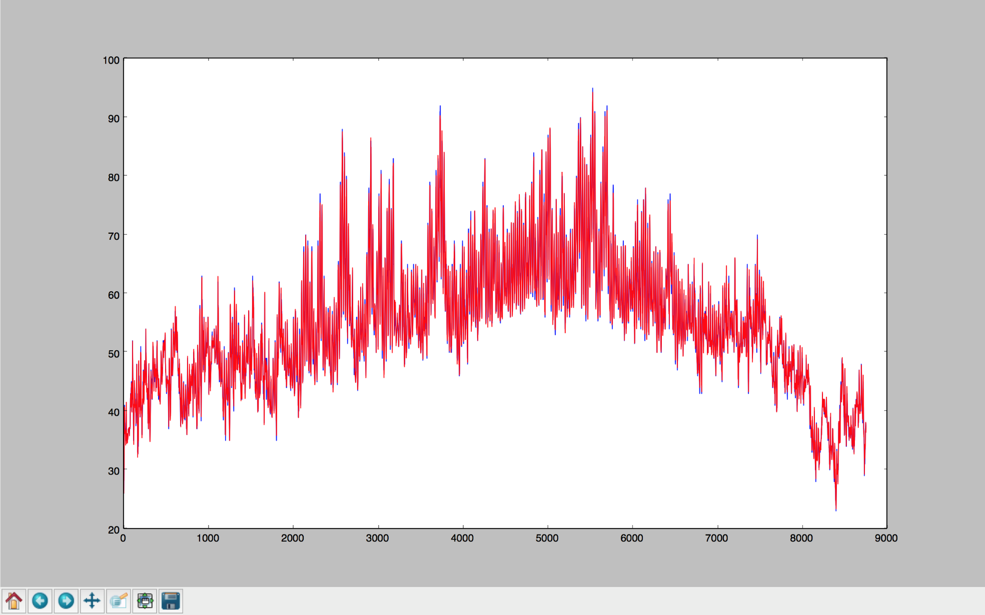
AR Results Seattle

Slide 19
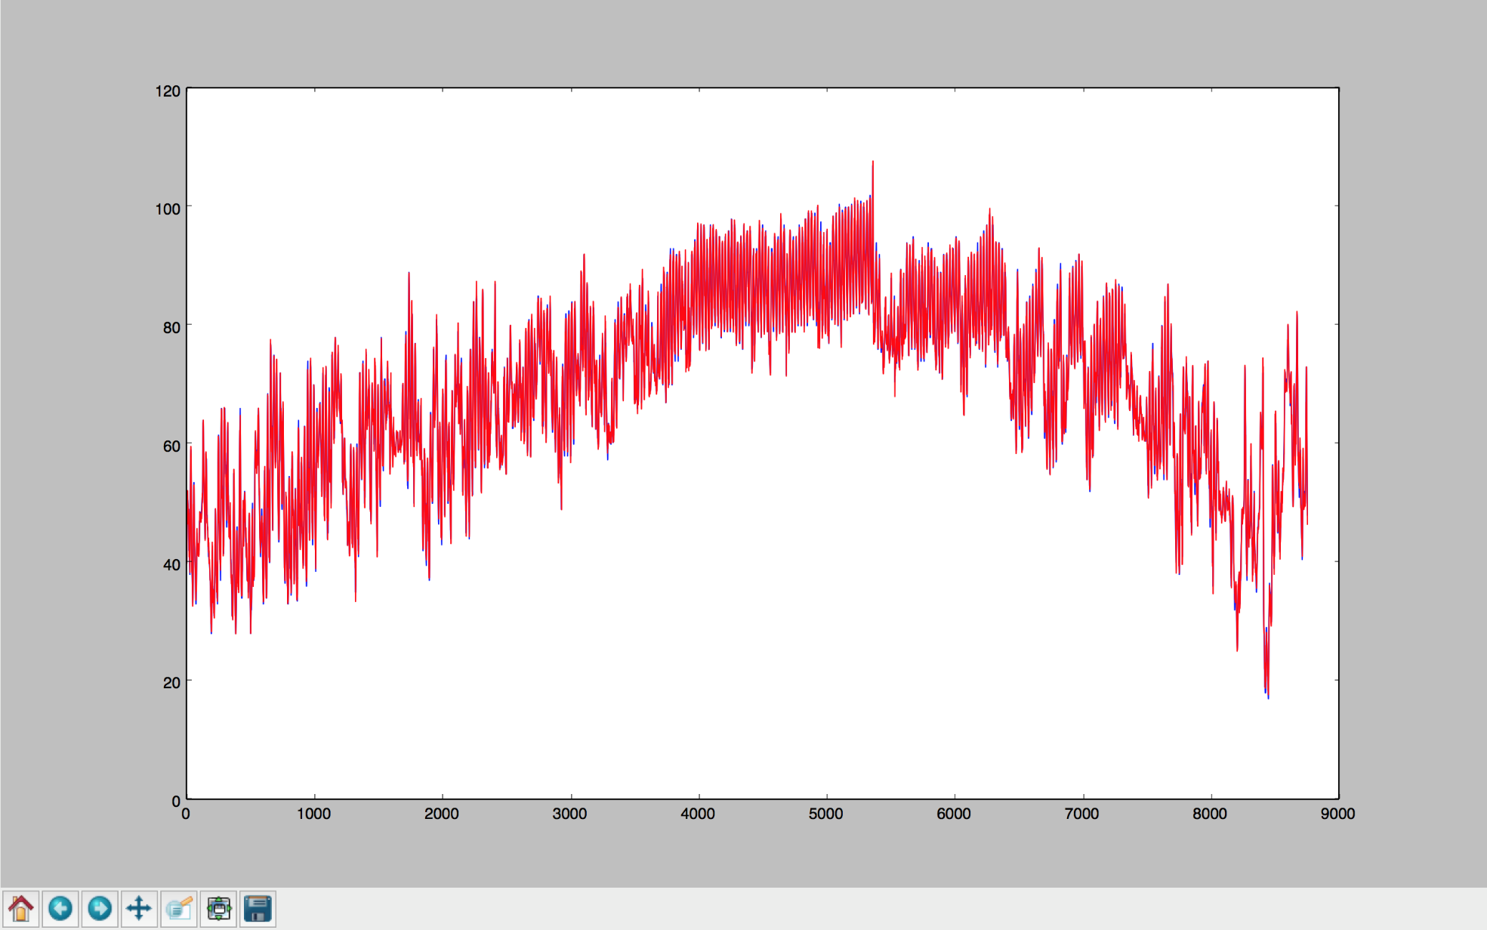
AR Results Dallas

Slide 20
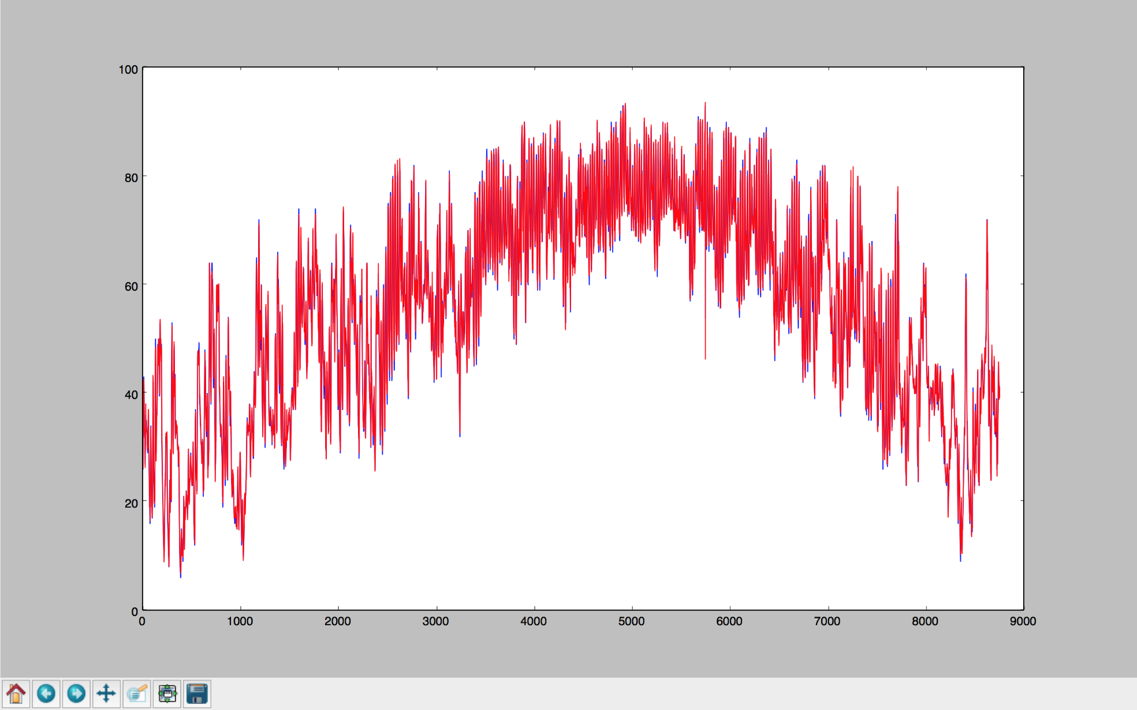
AR Results Cincinnati

Slide 21
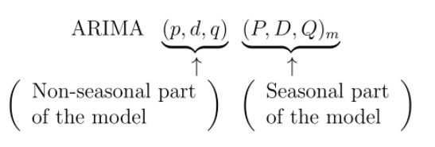
ARIMA
Combination of autoregressive (AR), integration (I) - and moving average (MA) operations.

Slide 22
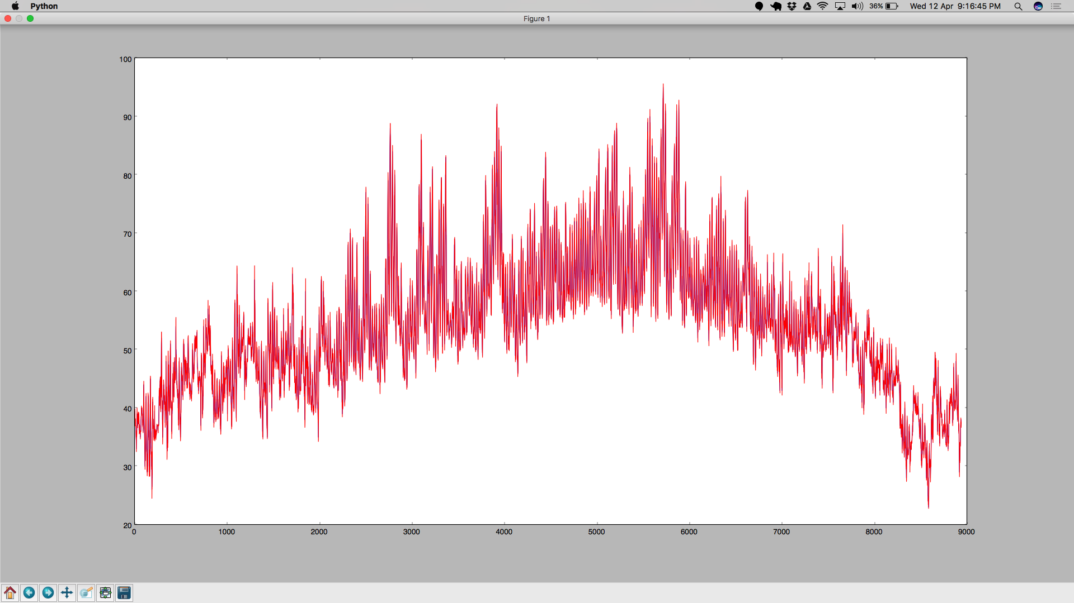
ARIMA Results Seattle

Slide 23
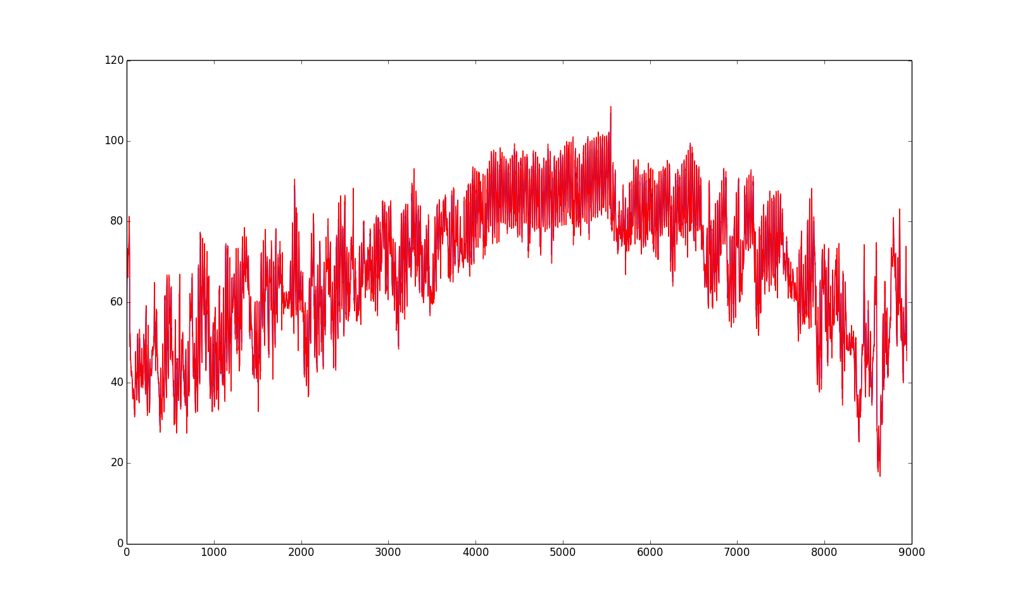
ARIMA Results Dallas

Slide 24

ARIMA Results Cincinnati

Slide 25
Nearest Neighbor Modeling
Created a lagged dataset (by 1 day)
Mapped attributes to next day’s temperature
Split data into train and test (random sampling)
Trained model with selected features

Slide 26
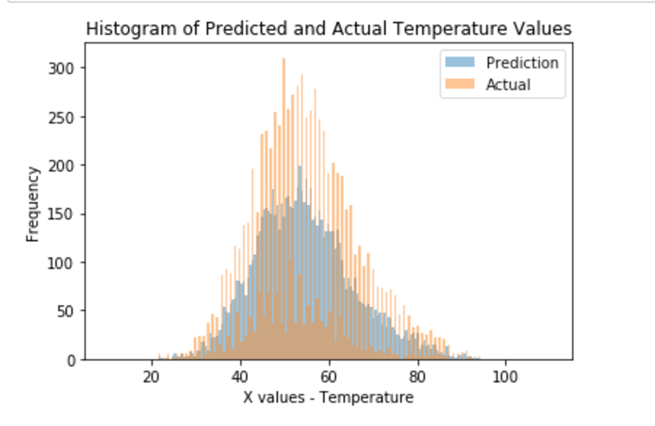
KNN Prediction Seattle

Slide 27
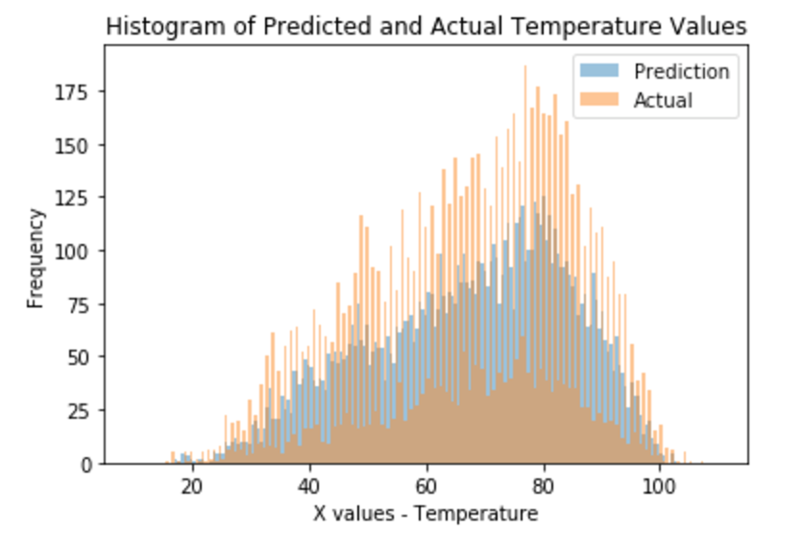
KNN Prediction Dallas

Slide 28
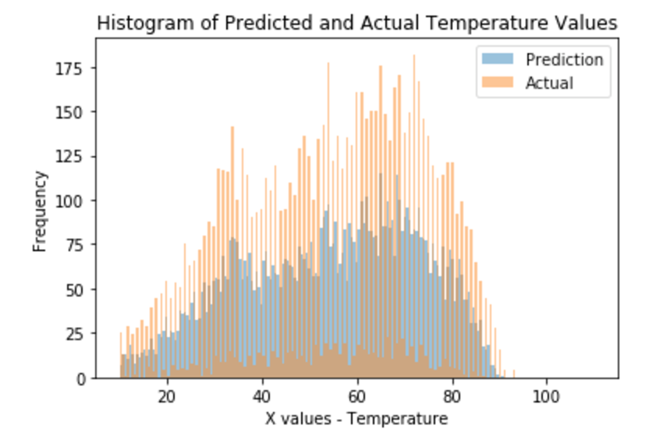
KNN Prediction Cincinnati

Slide 29
Time Series Linear Modeling
Linear model that retains the Time Series Characteristics
Includes seasonal and trend components
Includes external variables from Stepwise Regression

Slide 30
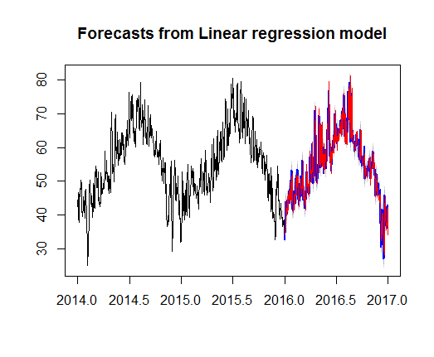
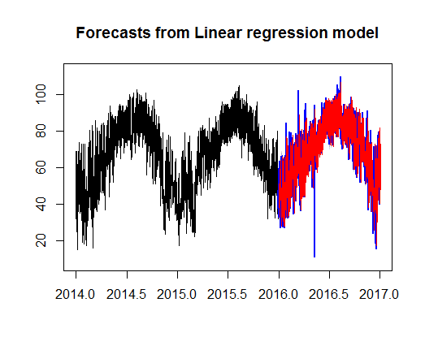
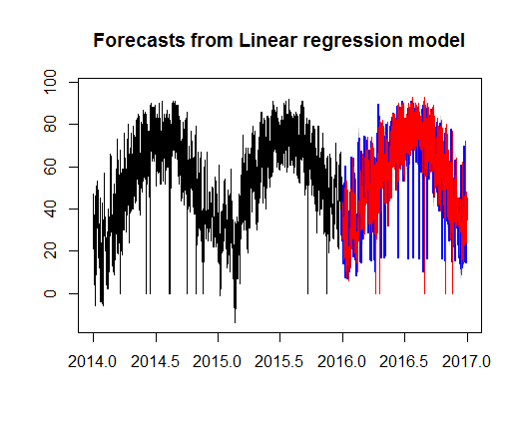
TSLM Predictions
Seattle
Dallas
Cincinnati

Slide 31
LSTM
It follows a recurrent neural network architecture.
Generally RNNs are good at remembering short term data and use it for computation.
In our case, Weather is something that is repetitive (With respect to seasons). LSTMs excel in this scenario, because it even considers the historical data that might be related to the present instant.
LSTM includes a forget gate, that throws away any information that is not needed. The rest are stored in the cell state.
We used tanh as our activation function.
We created a sequential model, which has LSTM in the beginning followed by a densely connected neural network layer.(This can be removed)

Slide 32
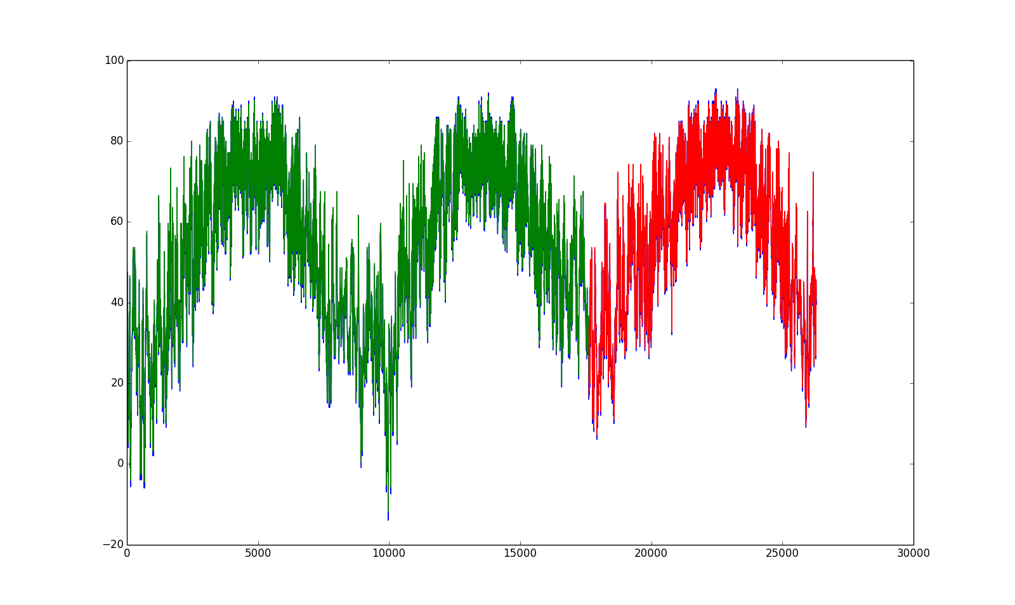
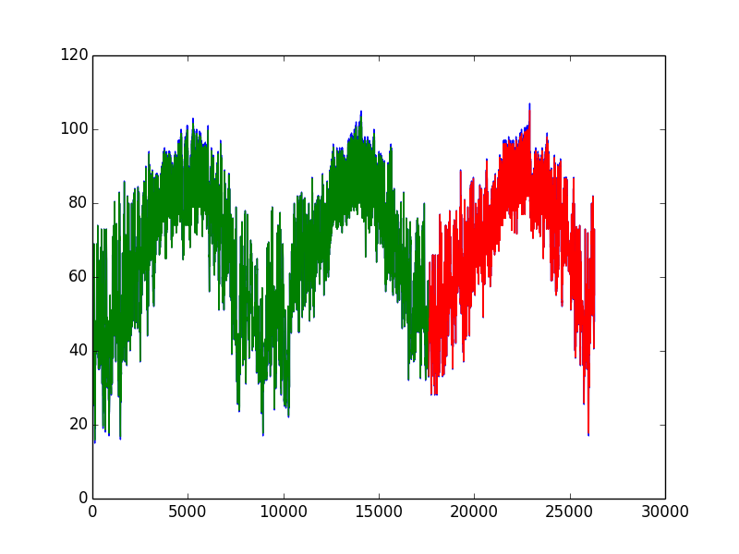
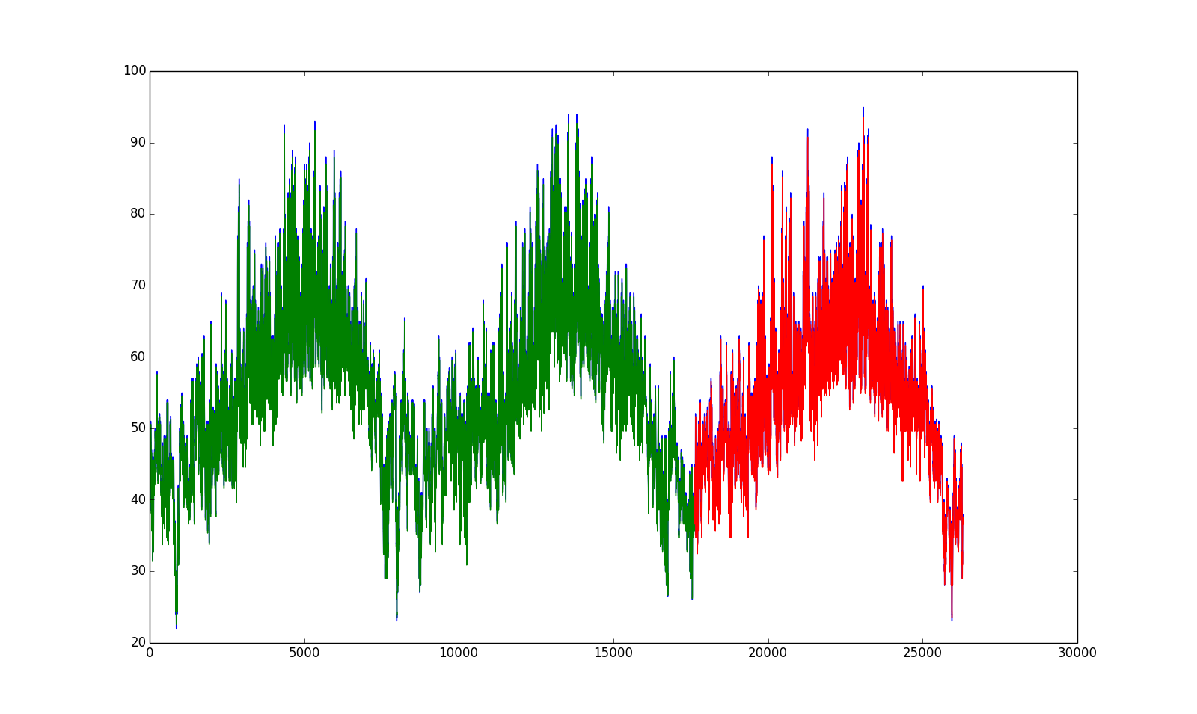
LSTM Predictions
Cincinnati
Dallas
Seattle

Slide 33
Results
Model | Seattle MSE | Dallas MSE | Cincinnati MSE
Baseline | 3.17 | 4.6 | 6.67
AR | 1.879 | 2.394 | 4.247
ARIMA | 2.437 | 3.337 | 5.247
TSLM | 3.4 | 13.2 | 14.8
KNN (k=4) | 3.617 | 6.75 | 8.019

Slide 34
Team Members
Balaji Sankar – 1209346459 - bsankar@asu.edu – 20% contribution
PCA
KNN
Karthik Subramanian – 1209360876 - ksubra19@asu.edu – 20% contribution
Data Preprocessing
KNN
Aarti Rao Manjeshwar – 1209163211 - amanjesh@asu.edu – 20% contribution
Baseline Persistence Model
Autocorrelation
Shwetha Narayanan – 1209166097 - snaray36@asu.edu – 20% contribution
Stepwise Regression
TSLM
Ramanathan Nachiappan – 1210822532 – rnachiap@asu.edu - 20% contribution
AR
ARIMA
“All the team members agree on the team members’ contributions in terms of both (a) what s/he did and (b) the percentage”

Slide 35
Thank You!
“All the team members agree on the team members’ contributions in terms of both (a) what s/he did and (b) the percentage”

